Slide 1
Chapter 4
SQL: Data Definition, Constraints, and Basic Queries and Updates

Slide 2
Chapter 4 Outline
SQL Data Definition and Data Types
Specifying Constraints in SQL
Basic Retrieval Queries in SQL
INSERT, DELETE, and UPDATE Statements in SQL
Additional Features of SQL

Slide 3
Basic SQL
SQL language
  Considered one of the major reasons for the commercial success of relational databases
SQL
  Structured Query Language
  Statements for data definitions, queries, and updates (both DDL and DML)
  Core specification
  Plus specialized extensions

Slide 4
SQL Data Definition and Data Types
Terminology:
  Table, row, and column used for relational model terms relation, tuple, and attribute
CREATE statement
  Main SQL command for data definition

Slide 5
Schema and Catalog Concepts in SQL
SQL schema
  Identified by a schema name
Schema elements include
  Tables, constraints, views, domains, and other constructs
Each statement in SQL ends with a semicolon

Slide 6
Schema and Catalog Concepts in SQL (cont’d.)
CREATE SCHEMA statement
  CREATE SCHEMA COMPANY AUTHORIZATION ‘Jsmith’;
Catalog
  Named collection of schemas in an SQL environment
SQL environment
  Installation of an SQL-compliant RDBMS on a computer system

Slide 7
The CREATE TABLE Command in SQL
Specify a new relation
  Provide name
  Specify attributes and initial constraints
Can optionally specify schema:
  CREATE TABLE COMPANY.EMPLOYEE ...
  or
  CREATE TABLE EMPLOYEE ...

Slide 8
The CREATE TABLE Command in SQL (cont’d.)
Base tables (base relations)
  Relation and its tuples are actually created and stored as a file by the DBMS
Virtual relations
  Created through the CREATE VIEW statement

Slide 9
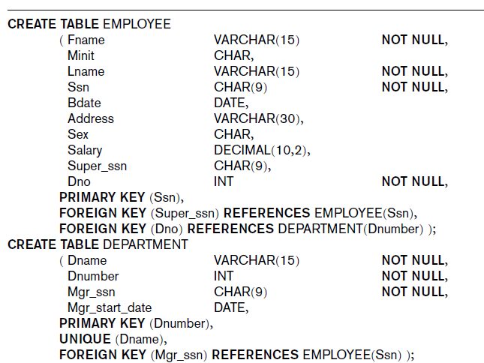
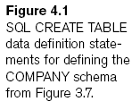

Slide 10
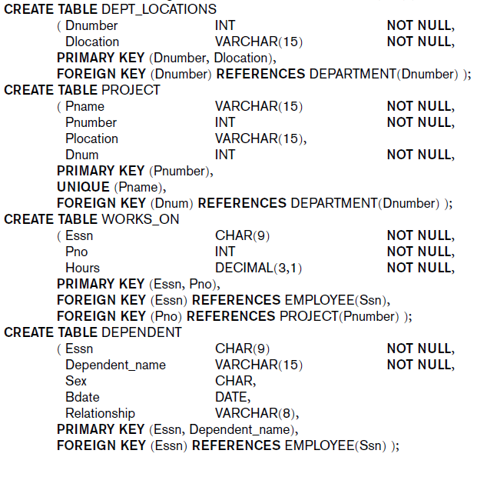

Slide 11
The CREATE TABLE Command in SQL (cont’d.)
Some foreign keys may cause errors
  Specified either via:
    Circular references
    Or because they refer to a table that has not yet been created

Slide 12
Attribute Data Types and Domains in SQL
Basic data types
  Numeric data types
    Integer numbers: INTEGER, INT, and SMALLINT
    Floating-point (real) numbers: FLOAT or REAL, and DOUBLE PRECISION
  Character-string data types
    Fixed length: CHAR(n), CHARACTER(n)
    Varying length: VARCHAR(n), CHAR VARYING(n), CHARACTER VARYING(n)

Slide 13
Attribute Data Types and Domains in SQL (cont’d.)
  Boolean data type
    Values of TRUE or FALSE or NULL
  DATE data type
    Ten positions
    Components are YEAR, MONTH, and DAY in the form YYYY-MM-DD

Slide 14
Attribute Data Types and Domains in SQL (cont’d.)
Domain
  Name used with the attribute specification
  Makes it easier to change the data type for a domain that is used by numerous attributes
  Improves schema readability
  Example:
    CREATE DOMAIN SSN_TYPE AS CHAR(9);

Slide 15
Specifying Constraints in SQL
Basic constraints:
  Key and referential integrity constraints
  Restrictions on attribute domains and NULLs
  Constraints on individual tuples within a relation

Slide 16
Specifying Attribute Constraints and Attribute Defaults
NOT NULL
  NULL is not permitted for a particular attribute
Default value
  DEFAULT <value>
CHECK clause
  Dnumber INT NOT NULL CHECK (Dnumber > 0 AND Dnumber < 21);

Slide 17
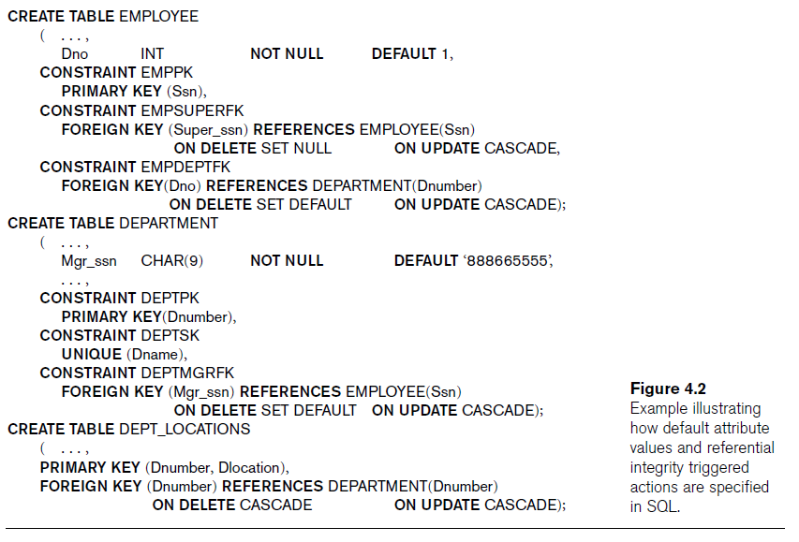

Slide 18
Specifying Key and Referential Integrity Constraints
PRIMARY KEY clause
  Specifies one or more attributes that make up the primary key of a relation
  Dnumber INT PRIMARY KEY;
UNIQUE clause
  Specifies alternate (secondary) keys
  Dname VARCHAR(15) UNIQUE;

Slide 19
Specifying Key and Referential Integrity Constraints (cont’d.)
FOREIGN KEY clause
  Default operation: reject update on violation
  Attach referential triggered action clause
    Options include SET NULL, CASCADE, and SET DEFAULT
    Action taken by the DBMS for SET NULL or SET DEFAULT is the same for both ON DELETE and ON UPDATE
    CASCADE option suitable for “relationship” relations

Slide 20
Specifying Constraints on Tuples Using CHECK
CHECK clauses at the end of a CREATE TABLE statement
  Apply to each tuple individually
  CHECK (Dept_create_date <= Mgr_start_date);

Slide 21
Basic Retrieval Queries in SQL
SELECT statement
  One basic statement for retrieving information from a database
SQL allows a table to have two or more tuples that are identical in all their attribute values
  Unlike relational model
  Multiset or bag behavior

Slide 22
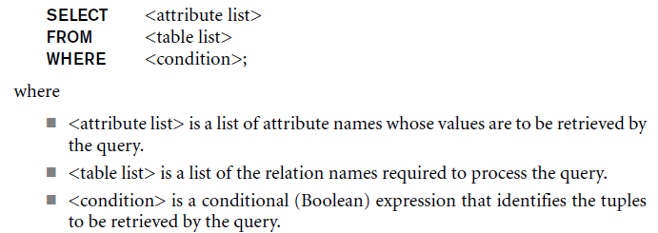
The SELECT-FROM-WHERE Structure of Basic SQL Queries
Basic form of the SELECT statement:

Slide 23
Query 3.1 All columns, all rows
List full details of all DVDs.
SELECT catalogNo, title, genre, rating
FROM DVD;
Can use * as an abbreviation for ‘all columns’:
SELECT *
FROM DVD;

Slide 24
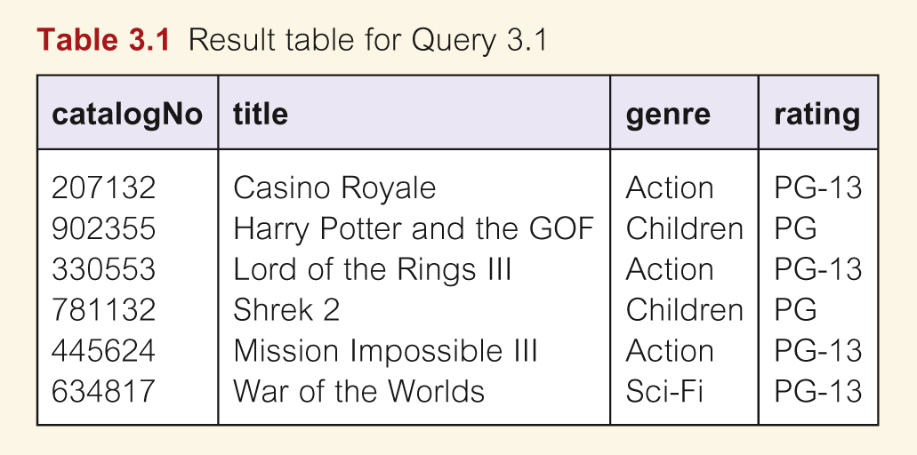
Query 3.1 All columns, all rows

Slide 25
Query 3.2 Specific columns, all rows
List the catalog number, title and genre of all DVDs.
  SELECT catalogNo, title, genre
  FROM DVD;

Slide 26
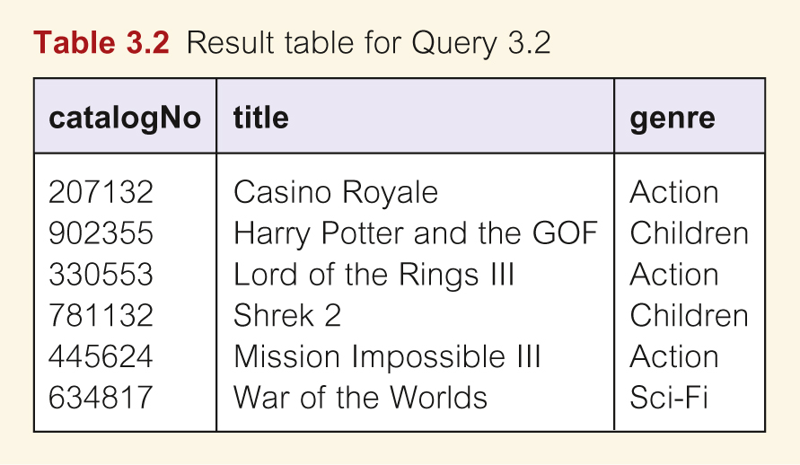
Table 3.2 Specific Columns, All Rows

Slide 27
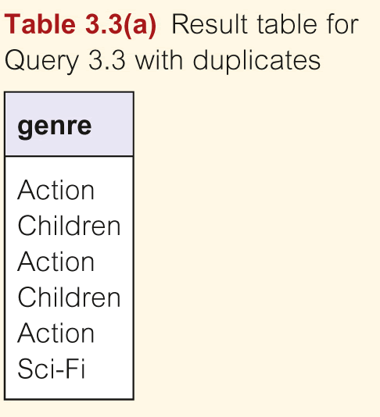
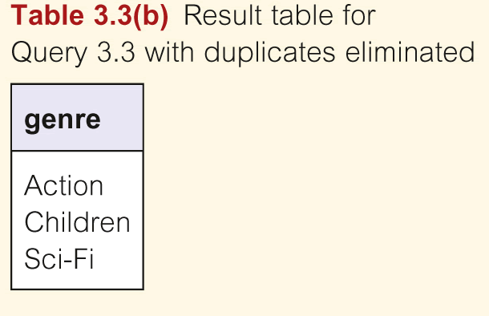
Query 3.3 Use of DISTINCT
List all DVD genres.
  SELECT genres
  FROM DVD;
  SELECT DISTINCT genres
  FROM DVD;

Slide 28
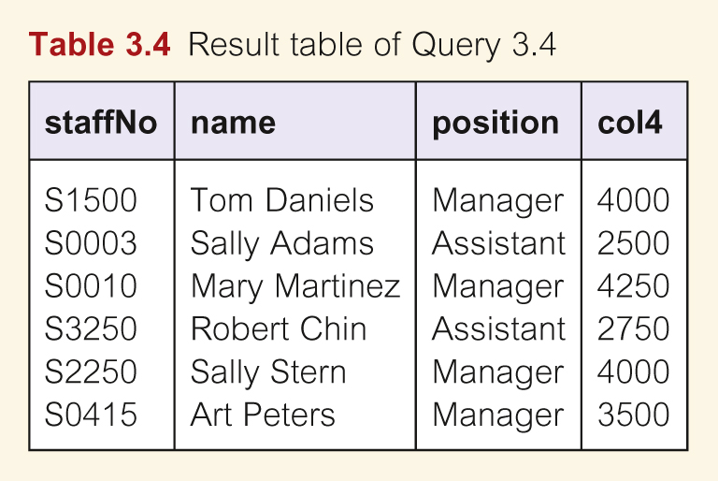
Calculated Fields
List the monthly salary for all staff, showing the staff number, name, position and monthly salary.
SELECT staffNo, name, position, salary/12
  FROM Staff;

Slide 29
Calculated Fields
To name column, use AS clause:
SELECT staffNo, name, position,
salary/12 AS monthlySalary
FROM Staff;

Slide 30
Result Table of Query 3.4

Slide 31
Row Selection (WHERE clause)
Five basic search conditions include:
  Comparison : compare the value of one expression to the value of another.
  Range: test whether value falls within a specified range.
  Set membership: test whether the value of an expression equals one of a set of values.
  Pattern match: test whether a string matches a specified pattern.
  Null: test whether a column has a unknown value.

Slide 32
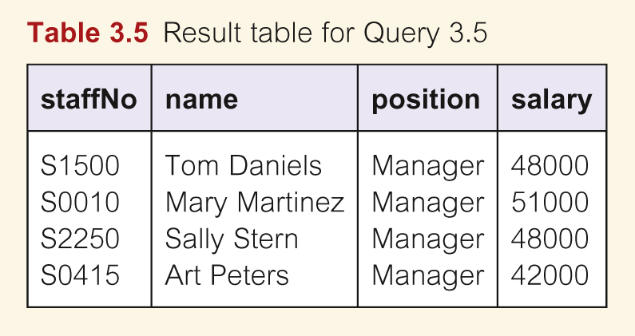
Query 3.5 Comparison Search Condition
List all staff with a salary greater than $40,000.
SELECT staffNo, name, position, salary
FROM Staff
WHERE salary > 40000;

Slide 33
Query 3.6 Range Search Condition
List all staff with a salary between $45,000 and $50,000.
SELECT staffNo, name, position, salary
  FROM Staff
  WHERE salary >= 45000 AND salary <= 50000;
Here we use the logical operator AND in the WHERE clause to find the rows in the Staff table where the value in the salary column is between $45 000 and $50 000

Slide 34
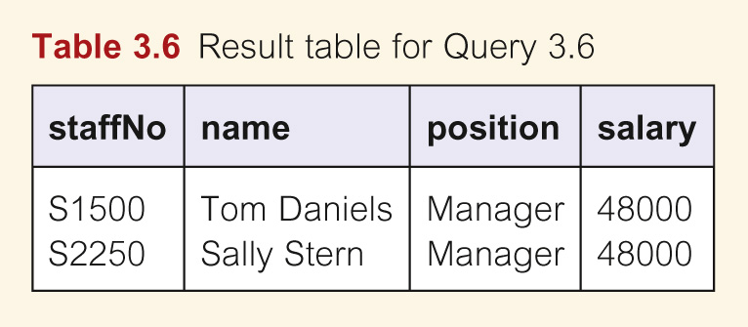
Result 3.6 Range Search Condition

Slide 35
Query 3.6 Range Search Condition
Also a negated version NOT BETWEEN.
BETWEEN does not add much to SQL’s expressive power. Could also write:
SELECT staffNo, name, position, salary
  FROM Staff
  WHERE salary BETWEEN 45000 and 50000;
Useful, though, for a range of values.

Slide 36
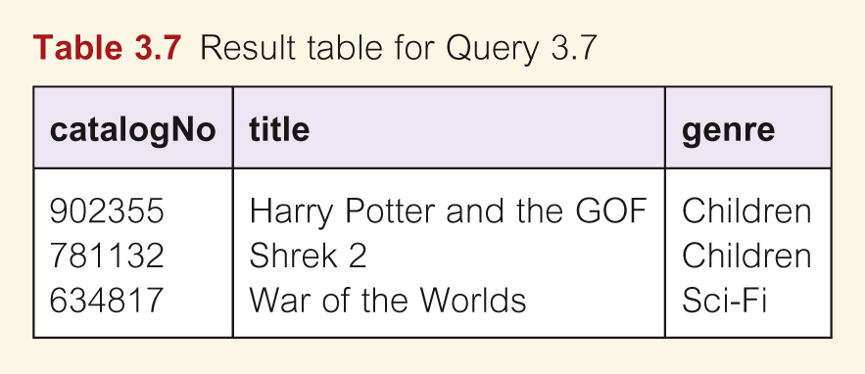
Query 3.7 Set Membership
List all DVDs in the Sci-Fi or Children genres.
  SELECT catalogNo, title, genres
  FROM DVD
  WHERE genre=‘Sci-Fi’ OR genre=‘Children’;

Slide 37
Query 3.7 Set Membership
There is a negated version (NOT IN).
IN does not add much to SQL’s expressive power. Could have expressed this as:
  SELECT catalogNo, title, genre
  FROM DVD
  WHERE genre IN (‘Sci-Fi’, ‘Children’);
IN is more efficient when set contains many values.

Slide 38
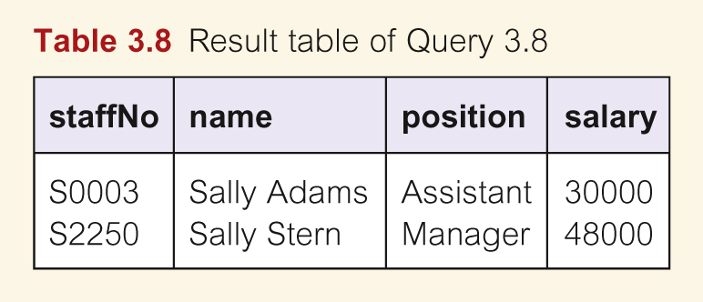
Query 3.8 Pattern Matching
List all staff whose first name is Sally.
SELECT staffNo, name, position, salary
  FROM Staff
  WHERE name LIKE ‘Sally%’;

Slide 39
Query 3.8 Pattern Matching
SQL has two special pattern matching symbols:
  %: sequence of zero or more characters;
  _ (underscore): any single character.
LIKE ‘Sally%’ means the first 5 characters must be Sally followed by anything.

Slide 40
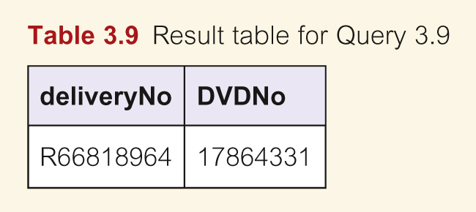
Query 3.9 NULL Search Condition
List the rentals that have no return date specified.
SELECT deliveryNo, DVDNo
  FROM DVDRental
  WHERE dateReturn IS NULL;
Have to test for null explicitly using special keyword IS NULL (IS NOT NULL).

Slide 41
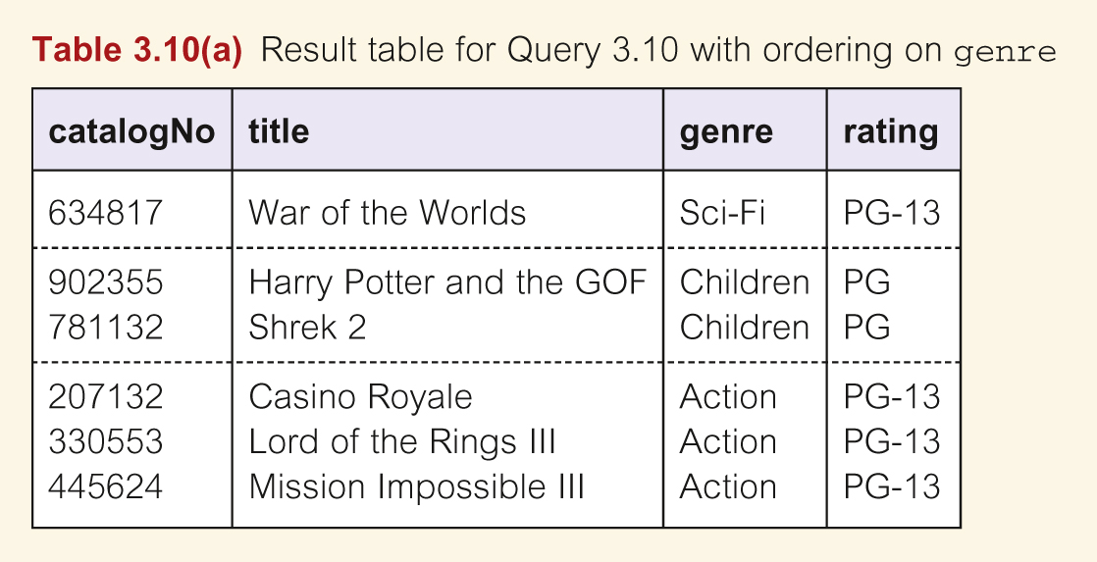
Sorting Results (ORDER BY)
List all DVDs, sorted in descending order of genre.
SELECT *
  FROM DVD
  ORDER BY genre DESC;

Slide 42
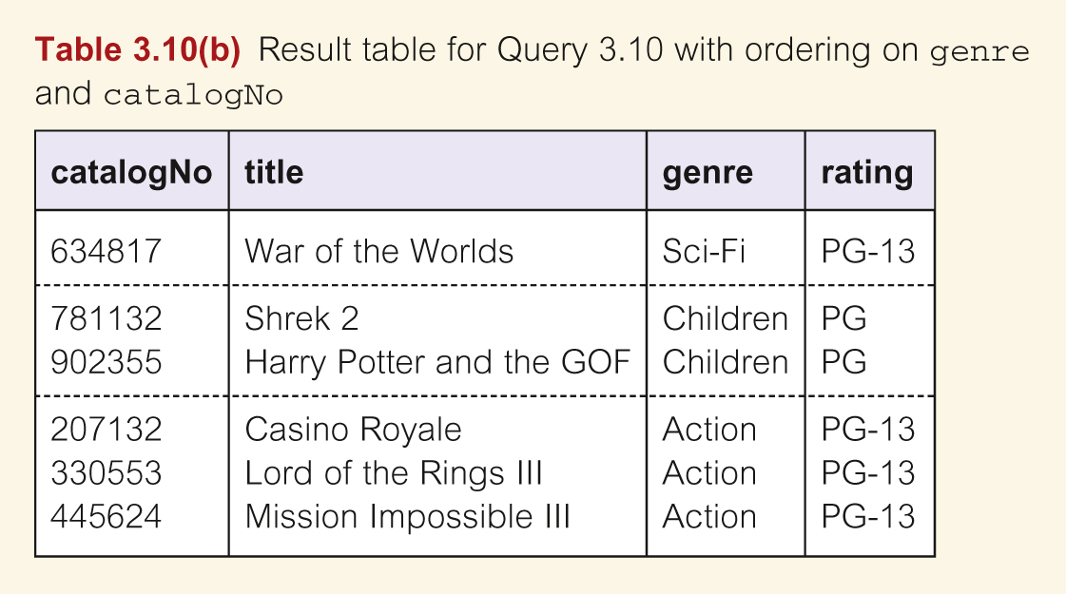
Table 3.10 Single Column Ordering
We can add a minor ordering clause to sort the same genres on catalogNo:
  ORDER BY genre DESC, catalogNo ASC;

Slide 43
Using the SQL Aggregate Functions
ISO SQL standard defines five aggregate functions:
COUNT Returns number of values in specified column.
SUM Returns sum of values in specified column.
AVG Returns average of values in specified column.
MIN Returns smallest value in specified column.
MAX Returns largest value in specified column.

Slide 44
Using the SQL Aggregate Functions
Each operates on a single column of a table and returns a single value.
COUNT, MIN, and MAX apply to numeric and non-numeric fields, but SUM and AVG only for numeric fields.
Apart from COUNT(*), each function eliminates nulls first and operates only on remaining non-null values.

Slide 45
Using the SQL Aggregate Functions
COUNT(*) counts all rows of a table, regardless of whether nulls or duplicate values occur.
Can use DISTINCT before column name to eliminate duplicates.
DISTINCT has no effect with MIN/MAX, but may have with SUM/AVG.

Slide 46
Using the SQL Aggregate Functions
Aggregate functions can be used only in SELECT list and in HAVING clause.
If SELECT list includes an aggregate function and there is no GROUP BY clause, SELECT list cannot reference a column out with an aggregate function.
For example, following is illegal:
SELECT staffNo, COUNT(salary)
  FROM Staff;

Slide 47
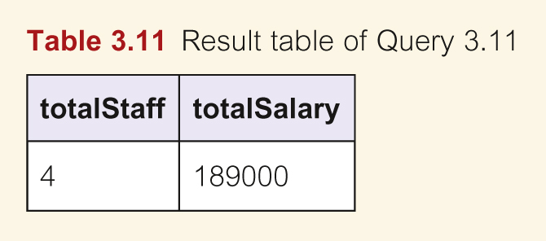
Query 3.11 Use of COUNT and SUM
List total number of staff with salary greater than $40,000 and the sum of their salaries.
  SELECT COUNT(staffNo) AS totalStaff,
  SUM(salary) AS totalSalary
  FROM Staff
  WHERE salary > 40000;

Slide 48
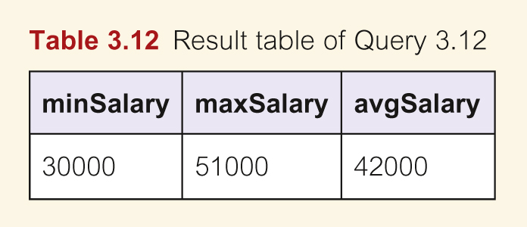
Query 3.12 Use of MIN, MAX, AVG
List the minimum, maximum, and average staff salary.
  SELECT MIN(salary) AS minSalary,
  MAX(salary) AS maxSalary,
  AVG(salary) AS avgSalary
  FROM Staff;

Slide 49
Grouping Results
Use GROUP BY clause to get sub-totals.
SELECT and GROUP BY closely integrated: each item in SELECT list must be single-valued per group, and SELECT clause may only contain:
  column names
  aggregate functions
  constants
  expression with combination of above.

Slide 50
Grouping Results
All column names in SELECT list must appear in GROUP BY clause unless used only in an aggregate function.
If used, WHERE is applied first, then groups are formed from remaining rows satisfying predicate.
ISO considers two nulls to be equal for purposes of GROUP BY.

Slide 51
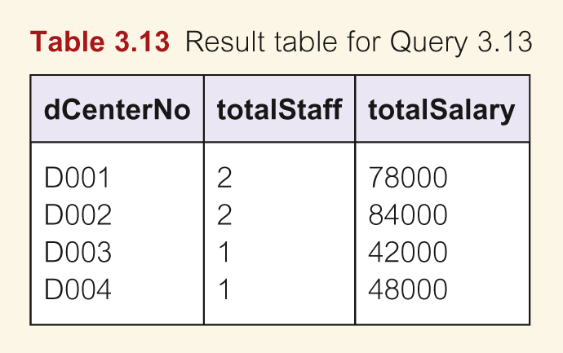
Query 3.13 Use of GROUP BY
Find number of staff working in each distribution center and the sum of their salaries.
  SELECT dCenterNo, COUNT(staffNo) AS totalStaff, SUM(salary) AS totalSalary
  FROM Staff
  GROUP BY dCenterNo
  ORDER BY dCenterNo;

Slide 52
Grouping Results by Clause
HAVING clause designed for use with GROUP BY to restrict groups that appear in final result table.
Similar to WHERE, but WHERE filters individual rows whereas HAVING filters groups.
Column names in HAVING clause must also appear in the GROUP BY list or be contained within an aggregate function.

Slide 53
Query 3.1.4 Use of HAVING
For each distribution center with more than 1 member of staff, find number of staff in each center and sum of their salaries.
  SELECT dCenterNo, COUNT(staffNo) AS totalStaff,
  SUM(salary) AS totalSalary
  FROM Staff
  GROUP BY dCenterNo
  HAVING COUNT (staffNo) > 1
  ORDER BY dCenterNo;

Slide 54
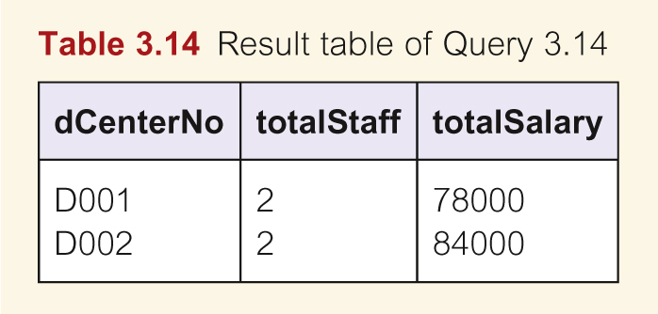
Results 3.14 Use of HAVING

Slide 55
Subselects
Some SQL statements can have a SELECT embedded within them.
A subselect can be used in WHERE and HAVING clauses of an outer SELECT, where it is called a subquery or nested query.
Subselects may also appear in INSERT, UPDATE, and DELETE statements.

Slide 56
Query 3.15 Using a subquery
Find staff who work in center at ‘8 Jefferson Way’.
SELECT staffNo, name, position
FROM Staff
WHERE dCenterNo=(SELECT dCenterNo
  FROM DistributionCenter
  WHERE dStreet=‘8 Jefferson Way’);

Slide 57
Using a Subquery
Inner SELECT finds distribution center number for distribution center at ‘8 Jefferson Way’ (‘B001’).
Outer SELECT then retrieves details of all staff who work at this center.
Outer SELECT then becomes:
  SELECT staffNo, name, position
    FROM Staff
    WHERE branchNo = ‘B001’;

Slide 58
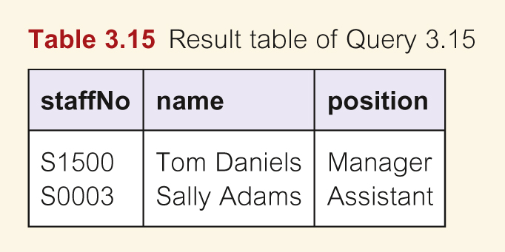
Results 3.15 Subquery

Slide 59
Query 3.16 Subquery with Aggregate
List all staff whose salary is greater than the average salary.
  SELECT staffNo, name, position
  FROM Staff
  WHERE salary >
    (SELECT AVG(salary)
    FROM Staff);

Slide 60
Query 3.16 Subquery with Aggregate
Cannot write ‘WHERE salary > AVG(salary)’
Instead, use subquery to find average salary (42000), and then use outer SELECT to find those staff with salary greater than this average:
  SELECT staffNo, name, position
  FROM Staff
  WHERE salary > 42000;

Slide 61
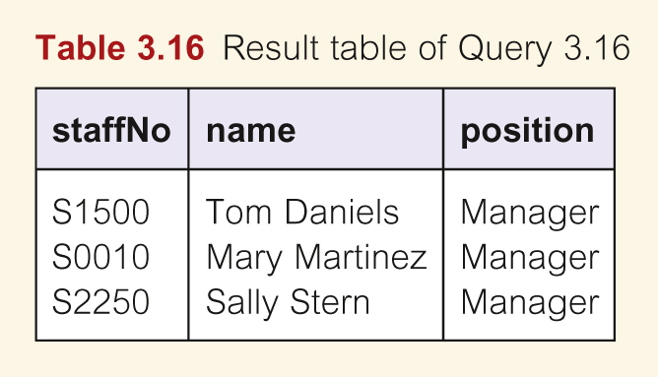
Query 3.16 Result Subquery with Aggregate

Slide 62
Subquery Rules: Key points
ORDER BY clause may not be used in a subquery (although it may be used in outermost SELECT).
Subquery SELECT list must consist of a single column name or expression, except for subqueries that use EXISTS.
By default, column names refer to table name in FROM clause of subquery. Can refer to a table in FROM using an alias.

Slide 63
Subquery Rules: Key points
When subquery is an operand in a comparison, subquery must appear on right-hand side.
A subquery may not be used as an operand in an expression.

Slide 64
Multi-Table Queries
Can use subqueries provided result columns come from same table.
If result columns come from more than one table must use a join.
To perform join, include more than one table in FROM clause.
Use comma as separator with typically a WHERE to specify join column(s).

Slide 65
Multi-Table Queries
Also possible to use an alias for a table named in FROM clause.
Alias is separated from table name with a space.
Alias can be used to qualify column names when there is ambiguity.

Slide 66
Query 3.17 Simple Join
List all actors and the characters they have played in DVDs.
SELECT a.actorNo, actorName, character
FROM Actor a, DVDActor da
WHERE a.actorNo = da.actorno:

Slide 67
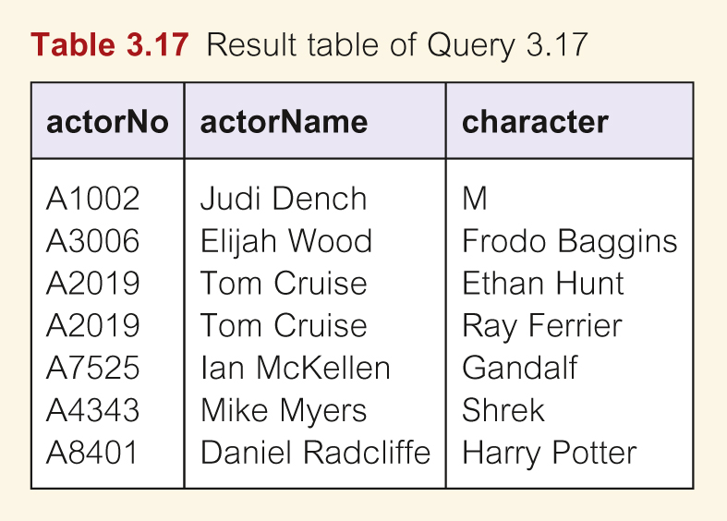
Simple Join
Only those rows from both tables with identical values in the actorNo columns (a. actorNo = da. actorNo) included in result.

Slide 68
Alternative JOIN Constructs
Alternative ways to specify joins:
FROM Actor a JOIN DVDActor da ON a.actorNo = da.actorNo;
FROM Actor JOIN DVDActor USING actorNo
FROM Actor NATURAL JOIN DVDActor

Slide 69
Query 3.18 Three Table Join
List all actors and the characters they have played in DVDs, along with the DVD’s title.
SELECT a. actorNo, actorName, character, title
FROM Actor a, DVDActor da, DVD d
WHERE a. actorNo = da.actorNo AND
da. catalogNo = d.catalogNo;

Slide 70
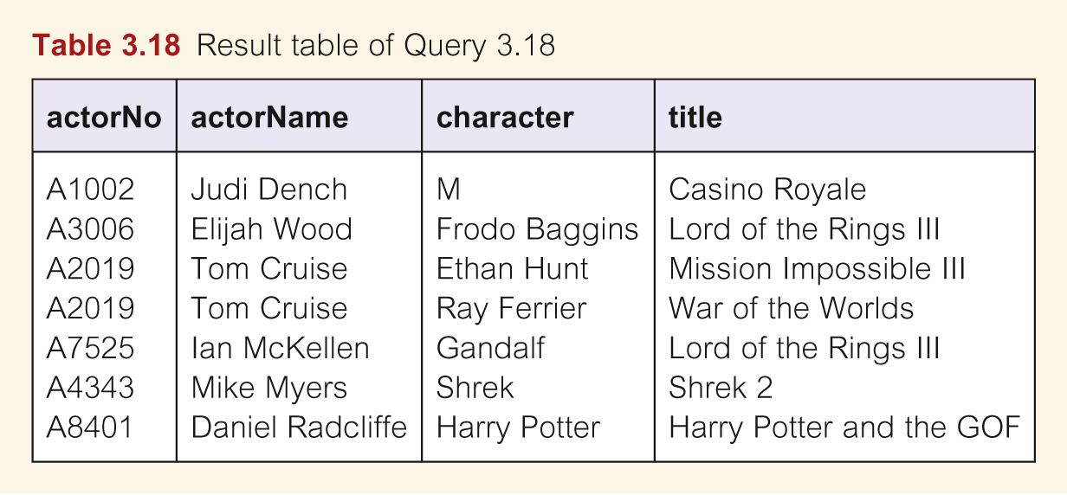
Query 3.18 Three Table Join

Slide 71
EXISTS and NOT EXISTS
The keywords EXISTS and NOT EXISTS are designed for use only with sub-queries. They produce a simple true/false result.
EXISTS is true if and only if there exists at least one row in the result table returned by the subquery; it is false if the subquery returns an empty table.
For simplicity, it is common for subqueries following one of these keywords to be of the form:
    (SELECT * FROM......)

Slide 72
Query 3.19 Query using EXISTS
Find all staff who work in the Washington distribution center.
SELECT staffNo, name, position
FROM Staff s
WHERE EXISTS (SELECT *
FROM DistributionCenter d
WHERE s.dCenterNo = d. dCenterNo
AND dState = ‘WA’);

Slide 73
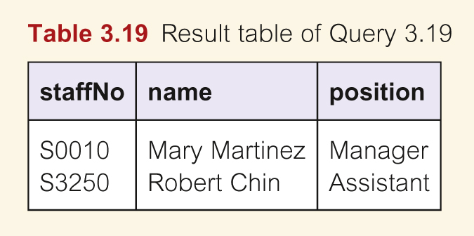
Query 3.19 Query Using EXISTS

Slide 74
INSERT – Add new row(s) to table
INSERT INTO TableName [ (columnList) ]
  VALUES (dataValueList)
columnList is optional; if omitted, SQL assumes a list of all columns in their original CREATE TABLE order.
Any columns omitted must have been declared as NULL or a DEFAULT was specified when table was created.

Slide 75
INSERT – Add new row(s) to table
dataValueList must match columnList as follows:
  number of items in each list must be same;
  must be direct correspondence in position of items in two lists;
  data type of each item in dataValueList must be compatible with data type of corresponding column.

Slide 76
Query 3.20 Insert a row into a table
Insert a row into the DVD table.
INSERT INTO DVD
  VALUES (‘207132’, ‘Casino Royale’, ‘Action’ ‘PG-13’);

Slide 77
UPDATE existing data in table
  The format of the UPDATE statement is:
  UPDATE TableName
  SET columnName1 = dataValue1
  [, columnName2 = dataValue2...]
  [WHERE searchCondition]
TableName can be name of a base table or an updatable view.
SET clause specifies names of one or more columns that are to be updated.

Slide 78
UPDATE existing data in table
WHERE clause is optional:
  if omitted, named columns are updated for all rows in table;
  if specified, only those rows that satisfy searchCondition are updated.
New dataValue(s) must be compatible with data type for corresponding column.

Slide 79
Query 3.21 UPDATE rows in a Table
Update the salary for all Managers with a 2% bonus.
UPDATE Staff
  SET salary = salary * 1.02
  WHERE position = ‘ Manager’;

Slide 80
DELETE rows of data from a table
  DELETE FROM TableName
  [WHERE searchCondition]
TableName can be name of a base table or an updatable view.
searchCondition is optional; if omitted, all rows are deleted from table. This does not delete table. If searchCondition specified, only those rows that satisfy condition are deleted.

Slide 81
Query 3.22 Delete rows in a table
Delete rental DVDs for catalog number 634817 .
DELETE FROM DVDcopy
  WHERE catalogNo = ‘634817’;

Slide 82
Query-By-Example (QBE)
QBE alternative graphical-based “point-and-click” way of querying database.
One of easiest ways for non-technical users to query database.
Query database by illustrating query to be answered using a template.

Slide 83
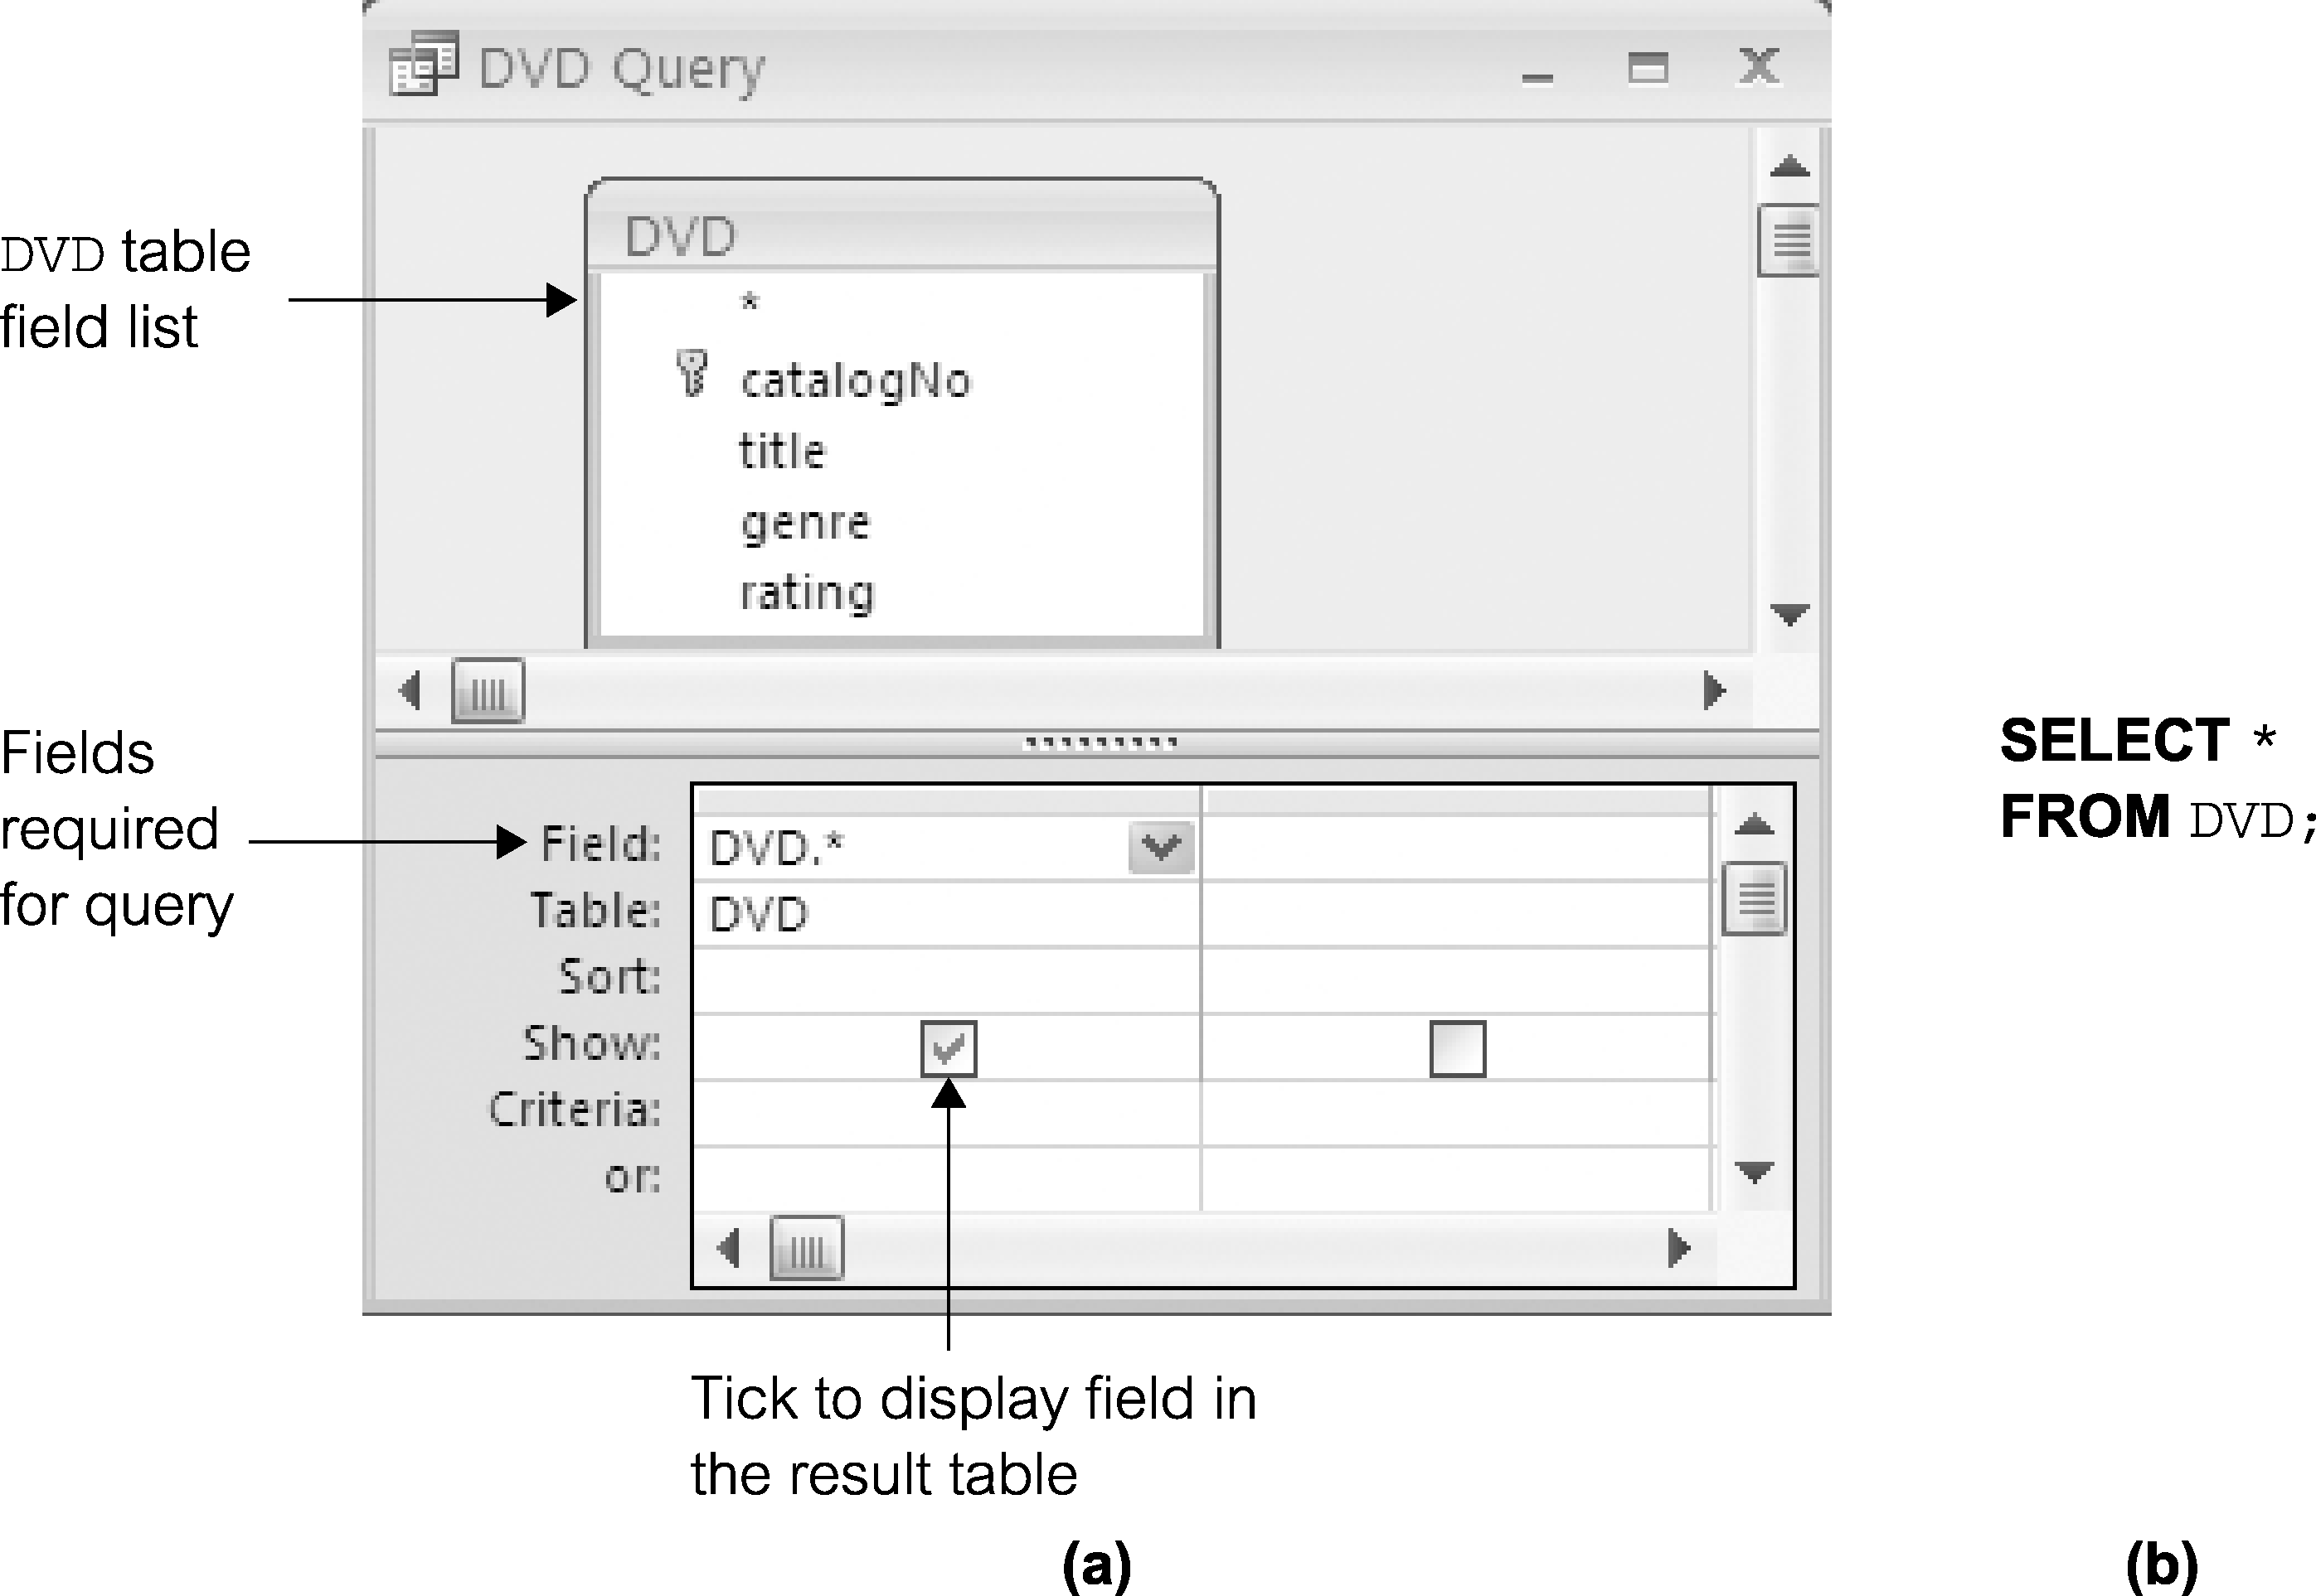
Query 3.1 (Revisited) All columns, all rows
83
Notes:
Chapter Name
September 98
83

Slide 84
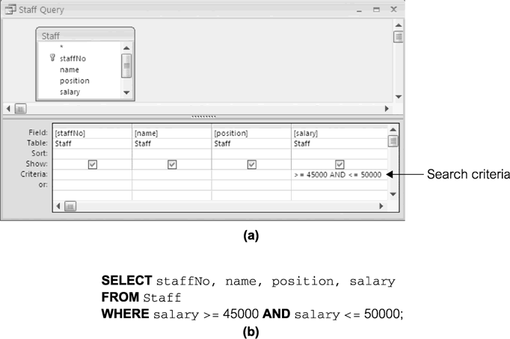
Query 3.6 (Revisited) Range Search Condition
84
Notes:
Chapter Name
September 98
84

Slide 85
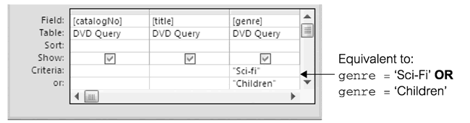
Query 3.6 (Revisited) Range Search Condition
85
Notes:
Chapter Name
September 98
85

Slide 86
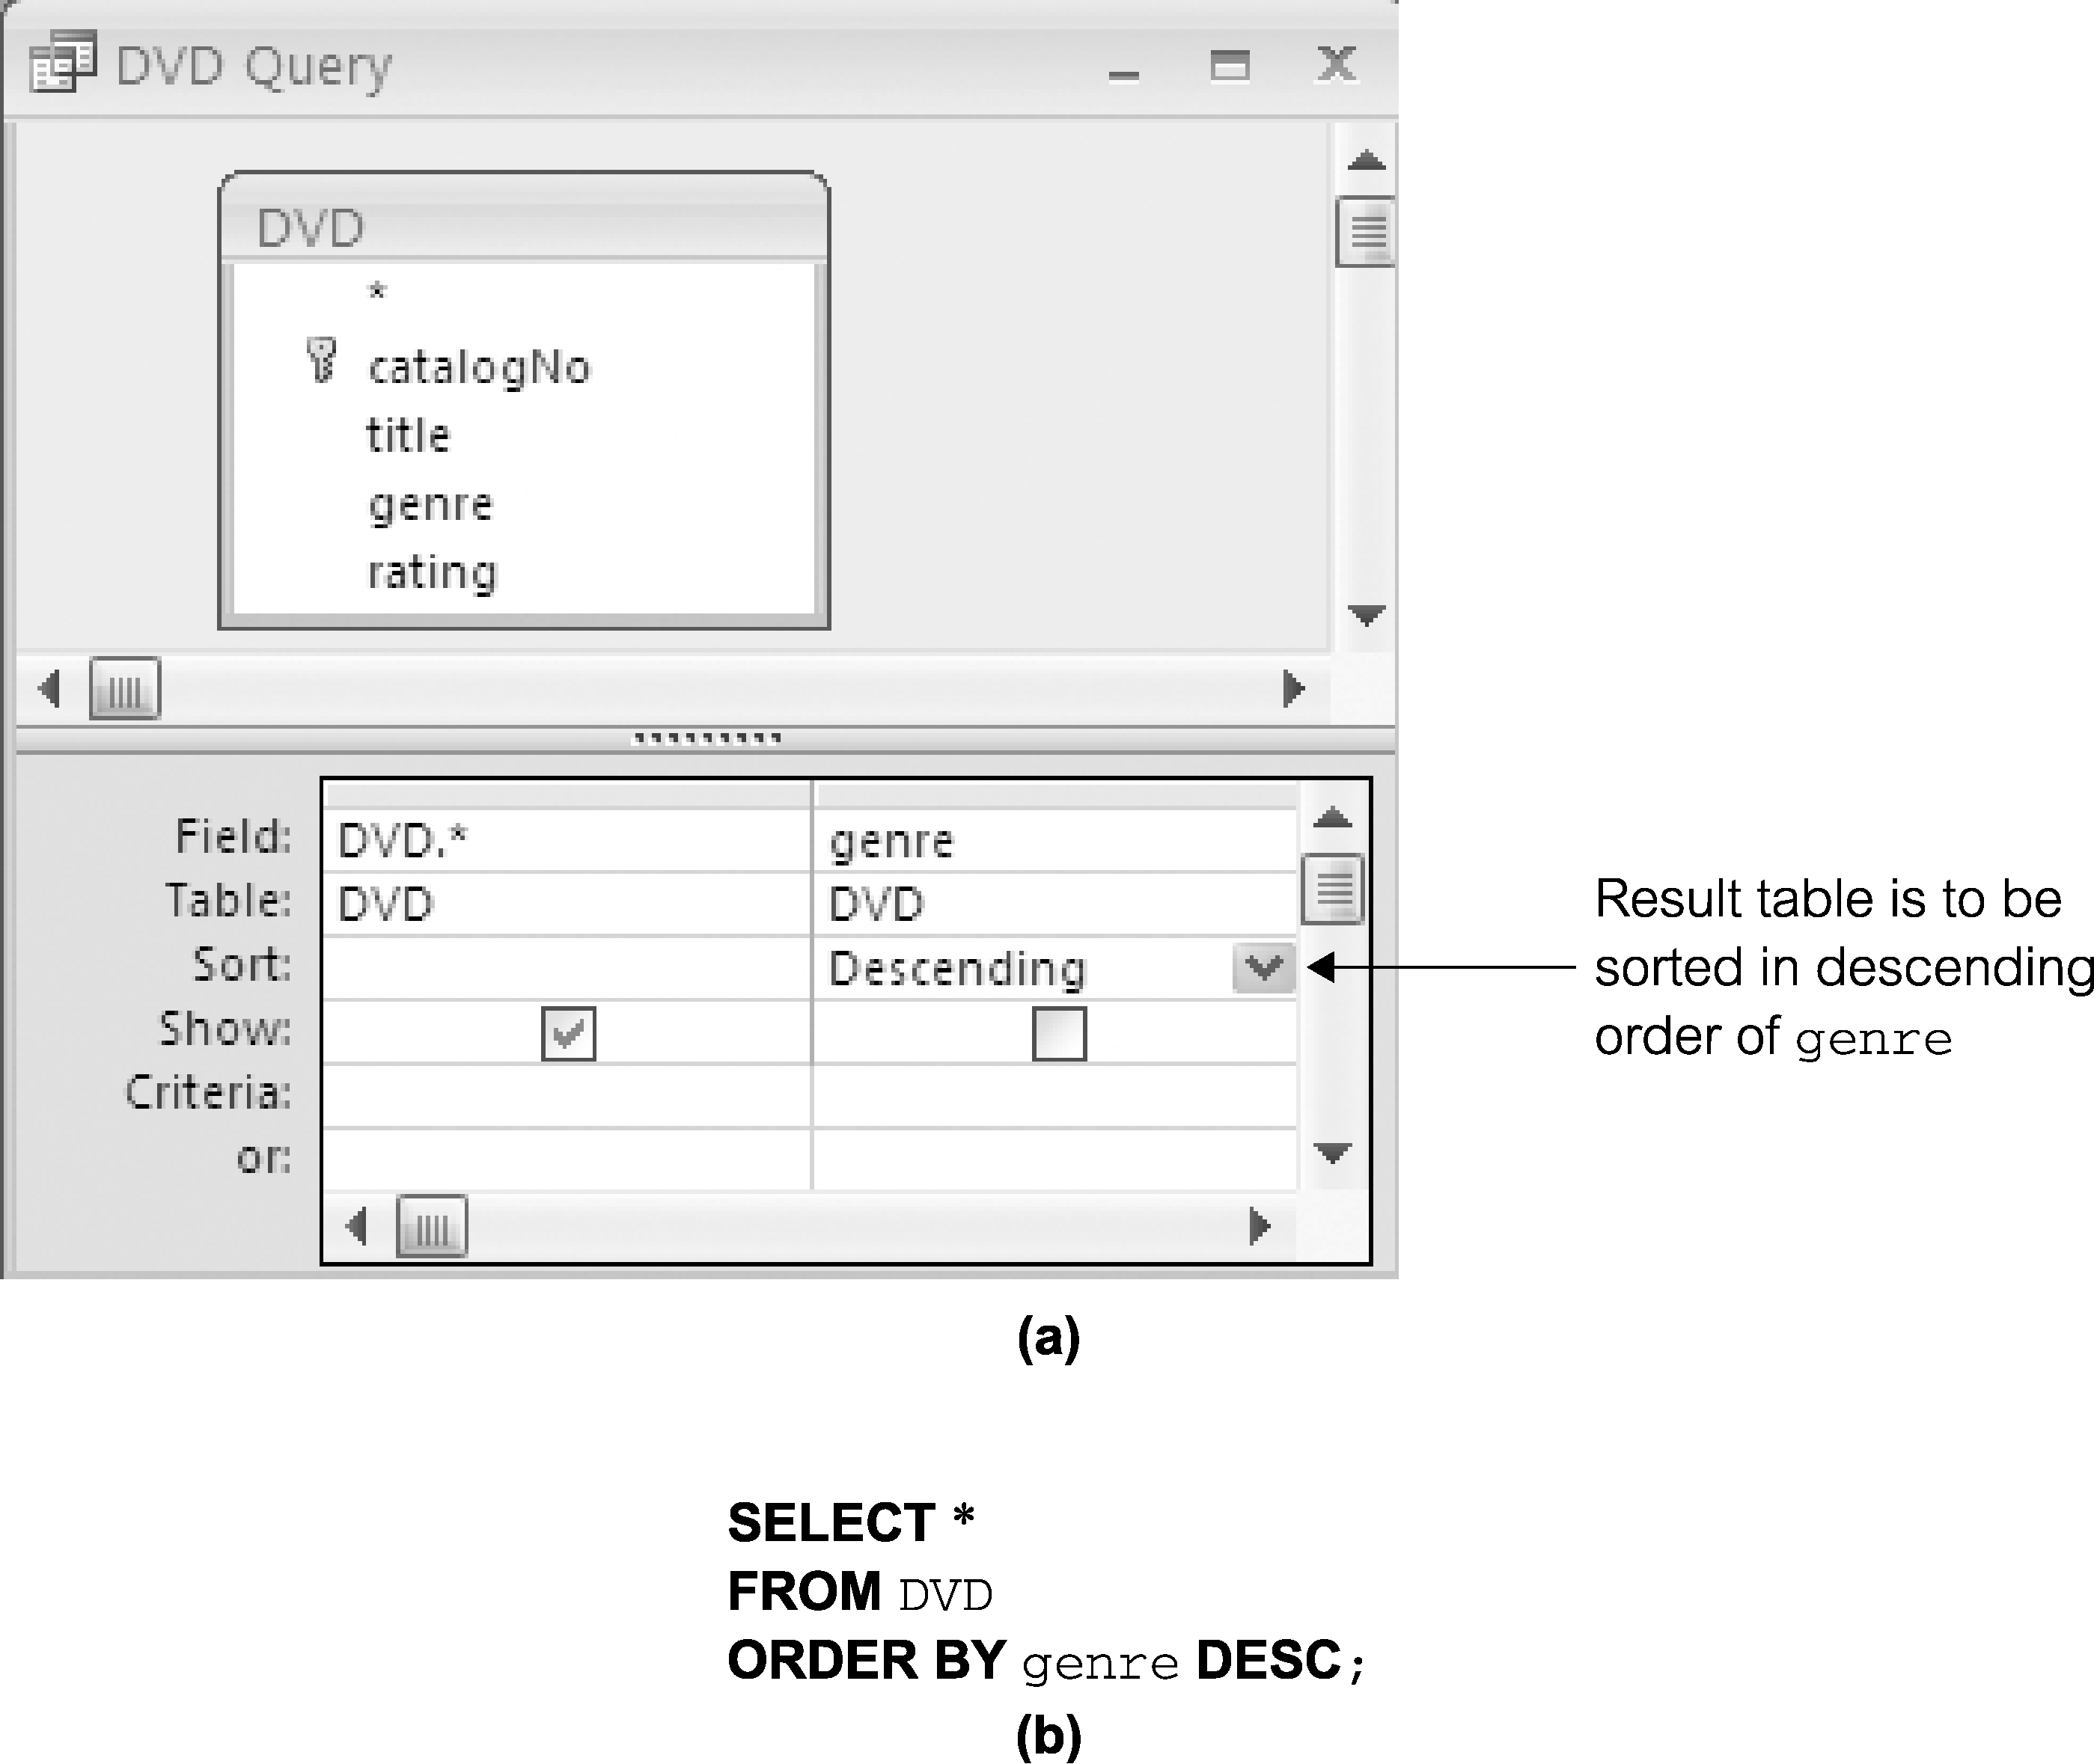
Table 3.10 (Revisited) Sorting results
86
Notes:
Chapter Name
September 98
86

Slide 87
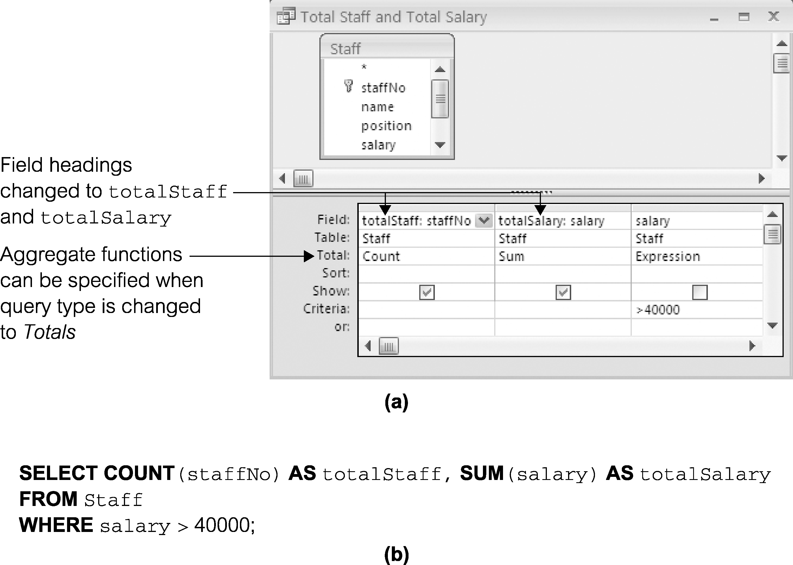
Query 3.11 (Revisited) Use of COUNT and SUM
87
Notes:
Chapter Name
September 98
87

Slide 88
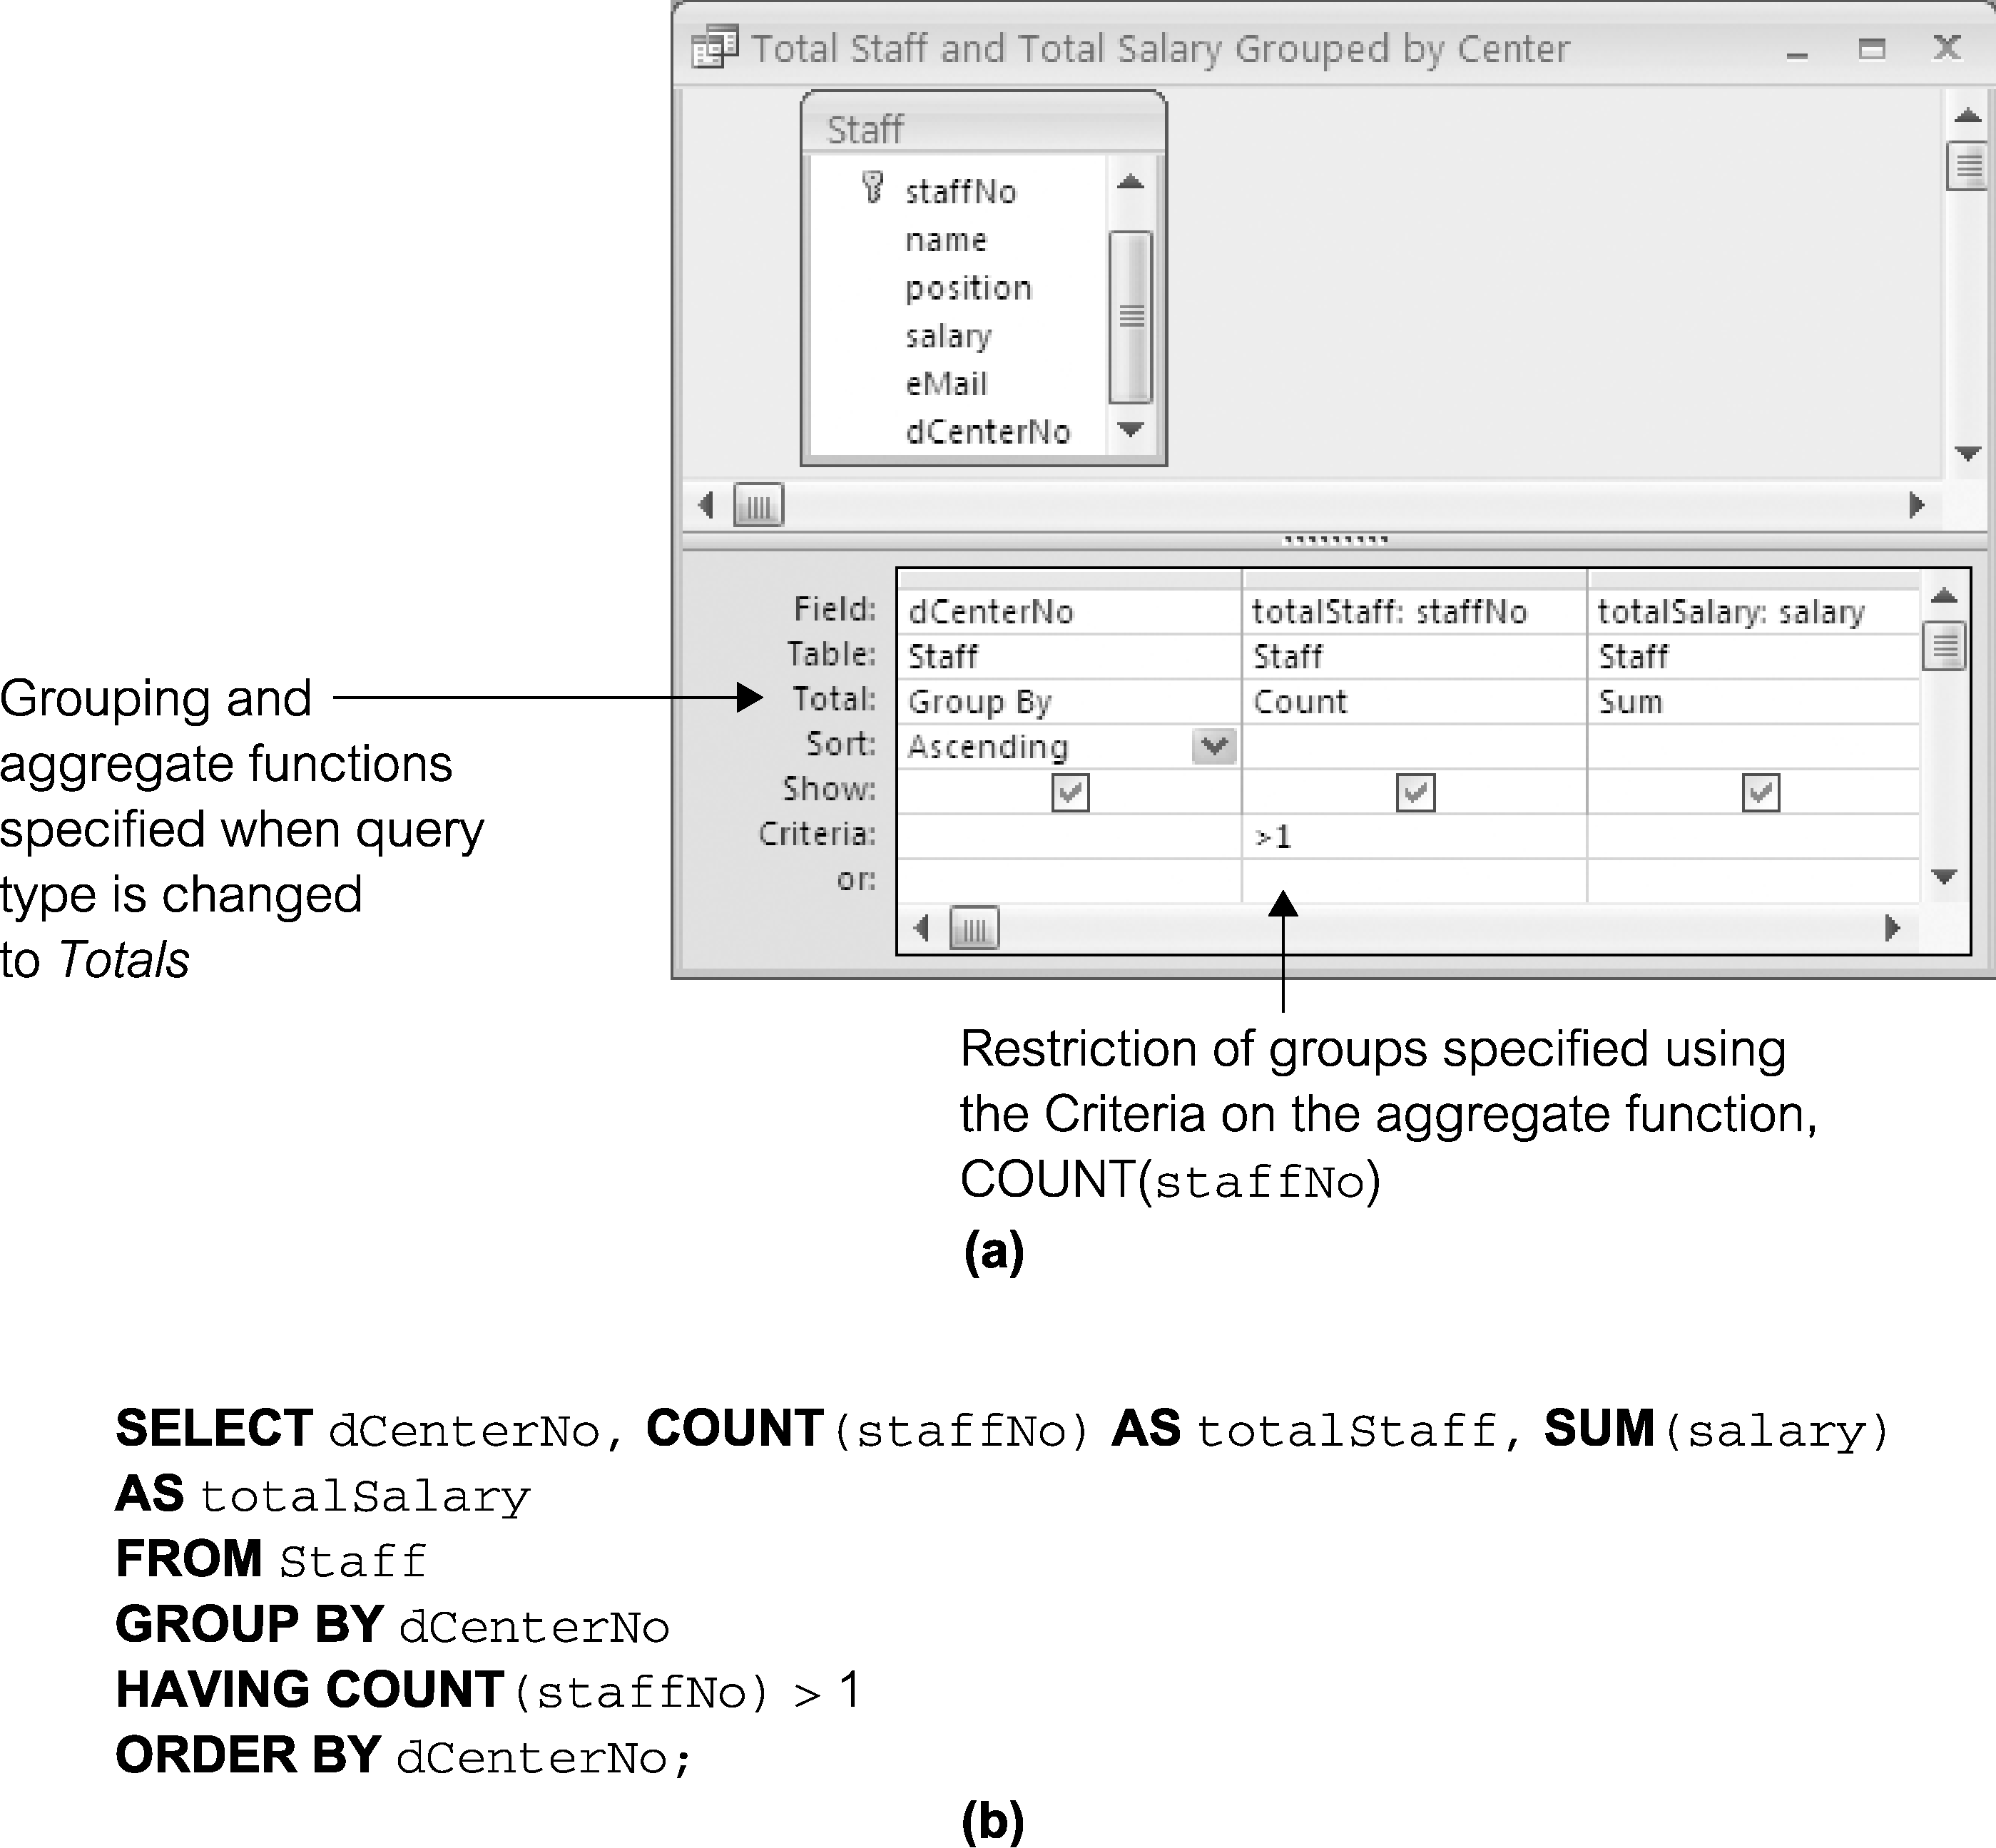
Query 3.14 (Revisited) Use of HAVING
88
Notes:
Chapter Name
September 98
88

Slide 89
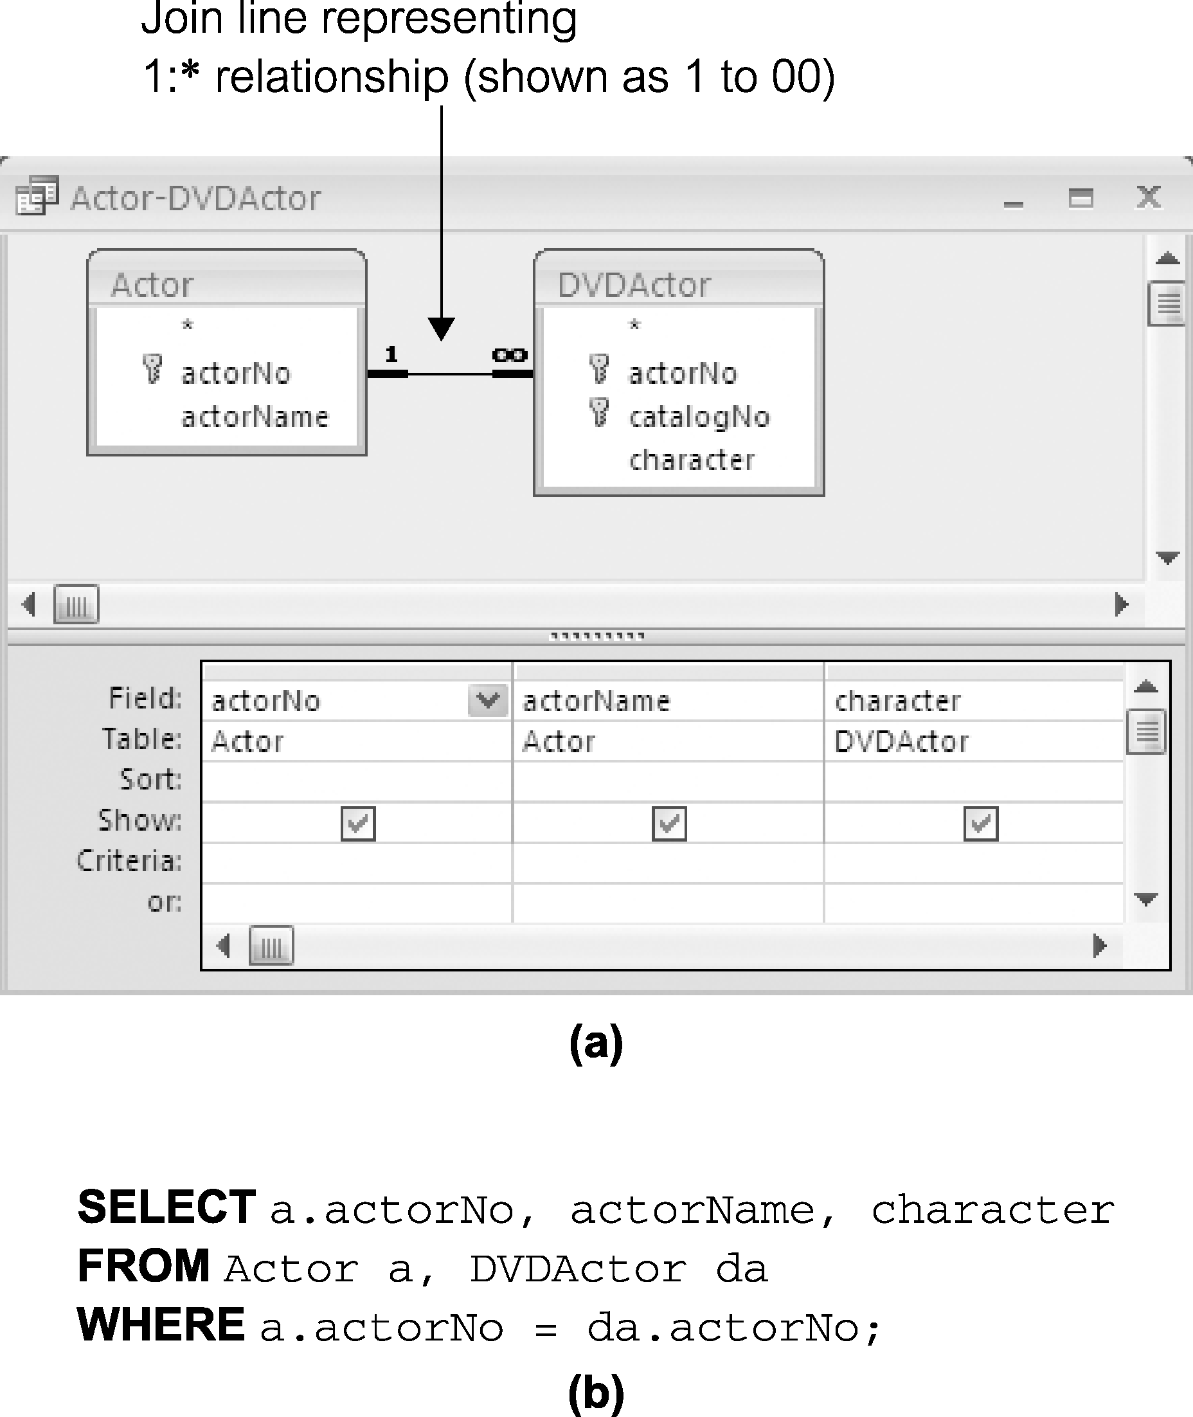
Query 3.17 (Revisited) Simple join
89
Notes:
Chapter Name
September 98
89

Slide 90
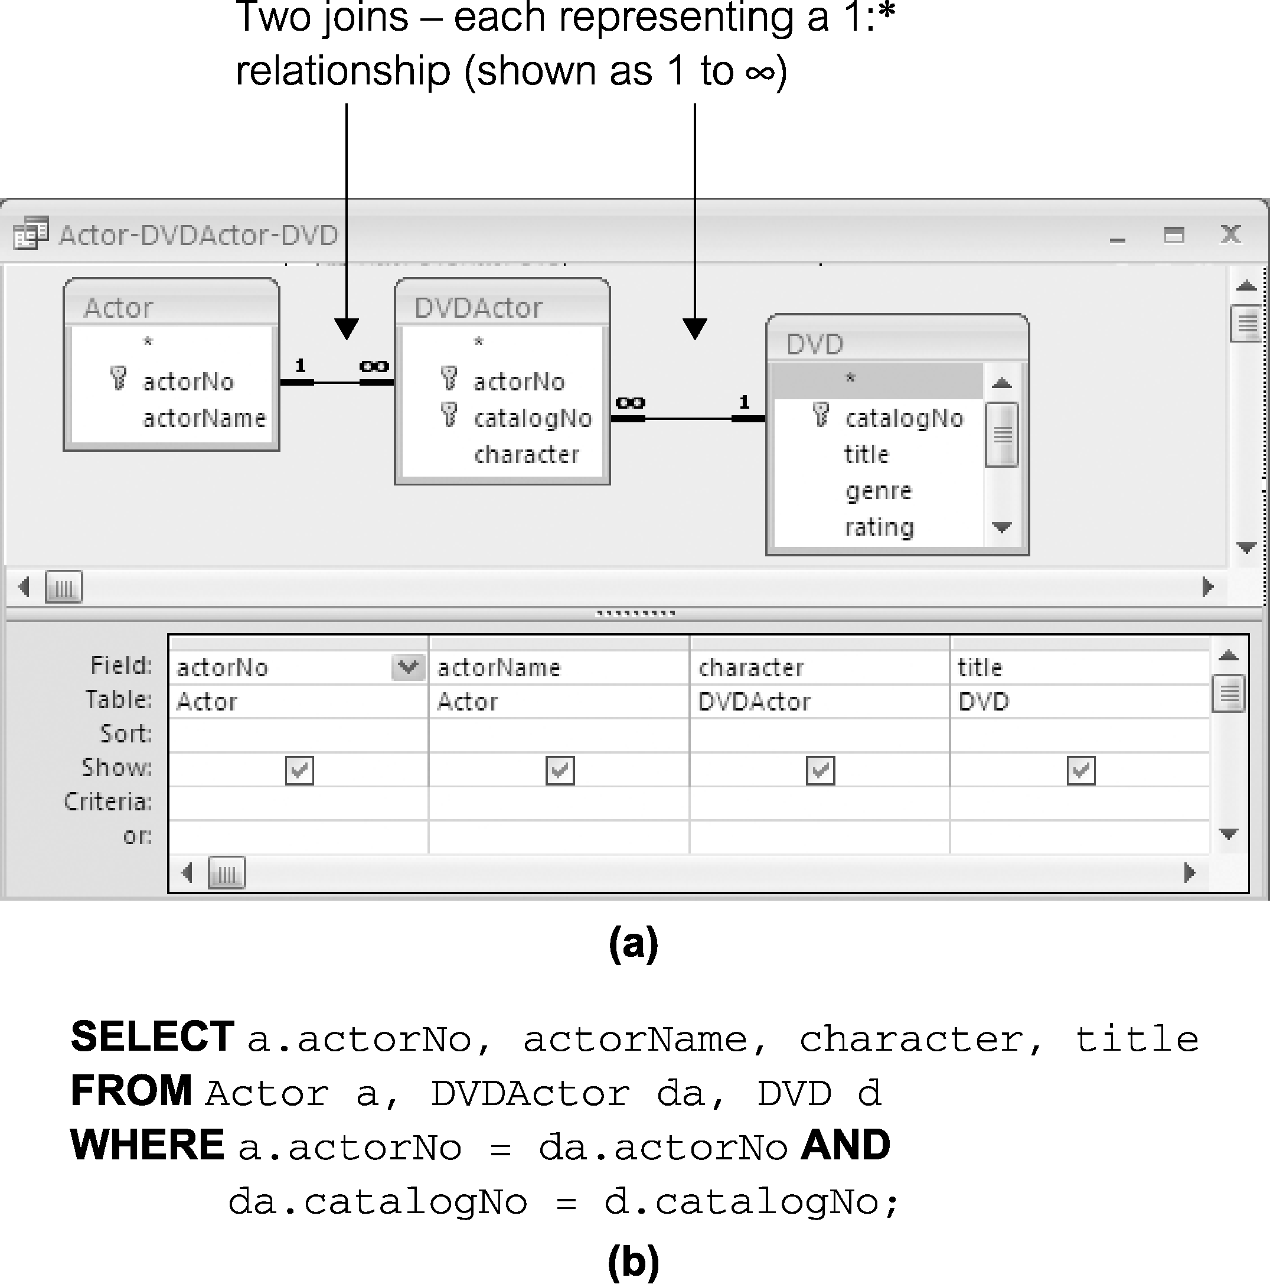
Query 3.18 (Revisited) Three table join
90
Notes:
Chapter Name
September 98
90

Slide 91
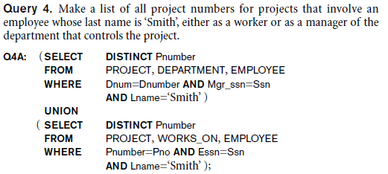
Tables as Sets in SQL (cont’d.)
Set operations
  UNION, EXCEPT (difference), INTERSECT
  Corresponding multiset operations: UNION ALL, EXCEPT ALL, INTERSECT ALL)

Slide 94
Summary
SQL
  Comprehensive language
  Data definition, queries, updates, constraint specification, and view definition
Covered in Chapter 4:
  Data definition commands for creating tables
  Commands for constraint specification
  Simple retrieval queries
  Database update commands

